Slide 1
Third Party Liability Services NASPO Procurement
2020 Third Party Liability Services
Bidders Conference for event 41900-DCH0000120
^{October 19, 2020 1:00pm}
Solicitation Event located here
^{Bidder’s Library located here}
Notes:
Gary

Slide 2
Agenda
Welcome & Meeting Purpose
Introductions/NASPO Overview
Solicitation Timeline and Question Submission Process
Procurement Overview & Goals
TPL Services/Categories
Overview of RFP documents
Review of Supplier Response Worksheets: Mandatory, Mandatory Scored
Review of Supplier Cost Worksheets
Evaluation/Scoring Process
Contracting Process
How to use Team Georgia Marketplace
Questions
Notes:
Gary
Welcome & Meeting Purpose - Gary (5 min)
Introductions/NASPO Overview – Gary/ Jerilyn (10 min)
Solicitation Timeline and Question Submission Process - Gary (5 min)
Procurement Overview & Goals- Peter (5 min)
TPL Services/Categories – Peter (5 min)
Participating States/Potential Users - Peter (5 min)
Overview of RFP documents - Czarina (10 min)
Review of Supplier Response Worksheets: Mandatory, Mandatory Scored- Czarina (15 min)
Review of Supplier Cost Worksheets - Peter/Tim P (1 hour)
Evaluation/Scoring Process - Peter (10 min)
Contracting Process- Jerilyn (10 min)
How to use Team Georgia Marketplace - Julian (20 min)
Questions- Gary (10min)

Slide 3
Welcome
Welcome! Your interest in doing business with the State of Georgia is appreciated.
Issuing Officer: Gary Craft gary.craft@DOAS.Ga.gov 404-6562287
Meeting Purpose: The Bidder’s Conference is an opportunity for the issuing officer to share the purpose of the Third Party Services RFP and explain the submission process to potential bidders.
Suppliers are required to submit an electronic business card to the Issuing Officer via email.
Suppliers are also required to remain on the conference for the entire session.
If a supplier leaves the conference early they will be excluded from further consideration.
All supplier communications must be directed to the Issuing Officer, Gary Craft.
Notes:
Gary

Slide 4
Introductions
Primary Team Members
Name | Title
Gary Craft | Issuing Officer, Georgia Department of Administrative Services
Czarina Woods | Agency Procurement Officer Deputy Director, Georgia Department of Community Health
Michelle Prescott | Deputy Director, Third Party Liability, Georgia Department of Community Health
Peter Herbert | Consultant, North Highland
Jerilyn Bailey | Cooperative Contract Coordinator, NASPO ValuePoint
McCall Ginsberg | Deputy General Counsel, Georgia Department of Administrative Services
Supporting Team Members
Annette Bazhaw | Director, Georgia Department of Community Health
Dana Harris | Group Manager, Georgia Department of Administrative Services
Virginia Catherine Cushing | Consultant, North Highland
Melanie Reid | Purchase/Procurement Agent, Georgia Department of Community Health
Fernando Puerto | Category Manager, Georgia Department of Community Health
Tim Peterson | MPATH Project Manager, Montana Department of Public Health and Human Services
Notes:
Gary

Slide 5
Who is NASPO ValuePoint?
NASPO ValuePoint is the cooperative purchasing arm of the National Association of State Procurement Officials.
NASPO Value Point’s nationwide Master Agreements are competitively solicited using a Lead State™ model, supported by a Sourcing Team™ comprised of multiple state procurement representatives and subject matter experts; leveraging the collective expertise and buying power of many states to deliver best value on price, quality, reliability, and service.
Notes:
Jerilyn

Slide 6
Key Dates
Dates to Remember
Written questions sent via email to the Issuing Officer are due on October 26, 2020 by 5:00pm ET
Responses to written questions will be provided by November 9, 2020*
Proposals are due on December 1, 2020 by 5:00pm ET*
*Note: the Lead State reserves the right to adjust the proposed listed dates, including the dates for evaluation, negotiations, award and the contract term on an as needed basis with or without notice.
Notes:
Gary

Slide 7
Purpose of RFP
eRFP: 41900-DCH0000120
Third Party Liability Services
Purpose of this RFP:
Pursuant to the State Purchasing Act (Official Code of Georgia Annotated §§50-5-50 et seq.) The State of Georgia (Lead State), Department of Administrative Services (DOAS), State Purchasing Division (SPD) is requesting proposals for Third Party Liability Services (TPL) in furtherance of the NASPO ValuePoint Cooperative Purchasing Program. Georgia has partnered with the following states on this solicitation as a part of the NASPO ValuePoint cooperative purchasing program: Louisiana, Missouri, Montana and Rhode Island. Additionally, we have received Intents to Participate (ITPs) from the following states: Alaska, Connecticut, Idaho, Louisiana, Maine, Missouri, Montana, New Mexico, Rhode Island, and Utah. Master Agreements will be established with those Suppliers whose proposals (technical and cost), contain solutions which are determined to offer the best overall value in the service categories to which they have responded.
The objective of this RFP is to identify qualified Suppliers whose proposals offer creative solutions which demonstrate that the Supplier(s) is(are) capable of increasing cost avoidance efforts while continuing to actively recover third party funds where necessary. Additionally, it seeks to unbundle the services historically provided by a single supplier, while placing a greater emphasis on cost avoidance, cost savings and implementing a new Medicaid Care Management Organization (CMO) Come Behind service, as well as a new Hospital-Physician service. As the Lead State, the State of Georgia is looking to obtain better value for the participating States because of the collective volume of potential purchases by multiple states and local government entities.
Notes:
Peter
The sourcing States seek to identify qualified suppliers who can offer creative solutions to increase cost avoidance efforts while continuing to actively recover third party funds where necessary.
The sourcing States seek to unbundle the services historically provided by a single supplier, while placing a greater emphasis on cost avoidance, cost savings and implementing a new Medicaid Care Management Organization (CMO) Come Behind service, as well as a new Hospital-Physician service.
The sourcing States are looking to obtain better value for the participating States because of the collective volume of potential purchases by multiple states and local government entities and to reduce the time and cost for States to procure these TPL services.

Slide 8
TPL Services/Categories
Five distinct TPL Services will be provided. Suppliers can bid on, and be selected, to provide one or more of these services. Multiple suppliers may be selected for each service if qualified. The first four services are business process related and the fifth is a system solution.
1. TPL Recovery Service
2. TPL Commercial Billing Recoupment Service
3. TPL Hospital/Physician Service
4. TPL Care Management Organization Come Behind Service
5. TPL System Module
Notes:
Peter

Slide 9
Participating States
Five States have collaborated to create the TPL RFP, with eleven states agreeing to utilize the subsequent awarded contracts.
Alaska
Connecticut
Georgia
Idaho
Louisiana
Maine
Missouri
Montana
New Mexico
Rhode Island
Utah
This is considered just the initial list of participating states; responding vendors should consider the national sales volume they could potentially achieve since all states, through this NASPO ValuePoint process, are eligible to utilize the awarded contracts that result from this RFP.
Notes:
Peter
Jerilyn to update slide

Slide 10
RFP Attachments
eRFP Instruction Document (provides an overview of the project and detailed submission instructions)
Mandatory Requirements (to which the Issuing Officer will assign a Pass or Fail score)
Mandatory Base Requirements (will be scored by the evaluation team to determine if suppliers meet the minimum requirements to move forward to have their responses to the mandatory scored requirements evaluated)
Mandatory Scored Requirements (also referred to as the Technical Proposal to which the Evaluation Team will award points based on defined scoring criteria)
Within the Mandatory Scored Requirements worksheets, suppliers are required to upload supporting documents, naming the uploaded files as instructed in the worksheet.
Cost Proposal (which will be given a weight based on the formula in Section 6.4 Scoring Criteria of the eRFP Instruction Document, and will be tallied with the technical score and oral presentations to create the overall score for the proposal (technical + oral presentations + cost)
Notes:
Czarina

Slide 11
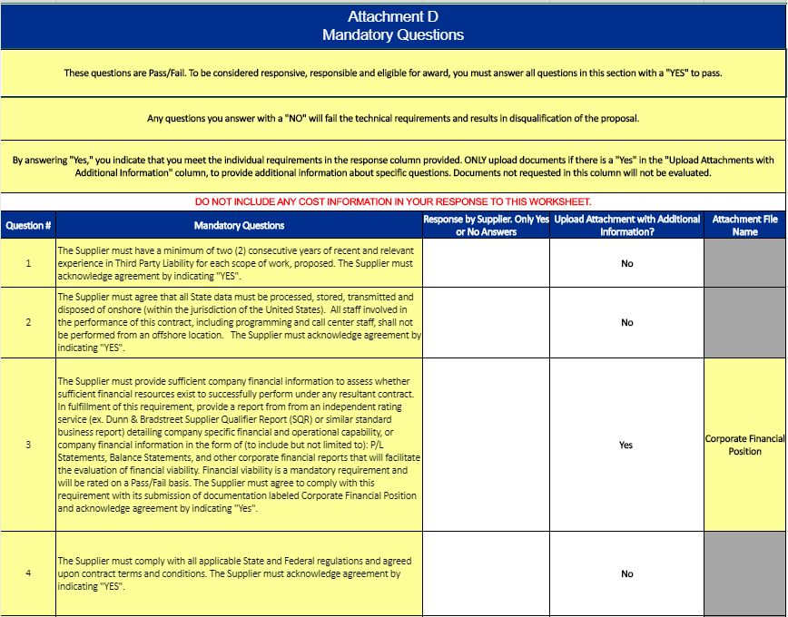
Mandatory Response Worksheet
Must respond to all questions with a “Yes” to qualify
Any “No” responses will result in the disqualification of the proposal
Questions include financial position, onshore operations & data, services bid, MECT checklist, assurances
Upload requested attachments to the procurement system using the attachment file name provided
Please be sure to note where attachment
files are required*
Notes:
Czarina

Slide 12
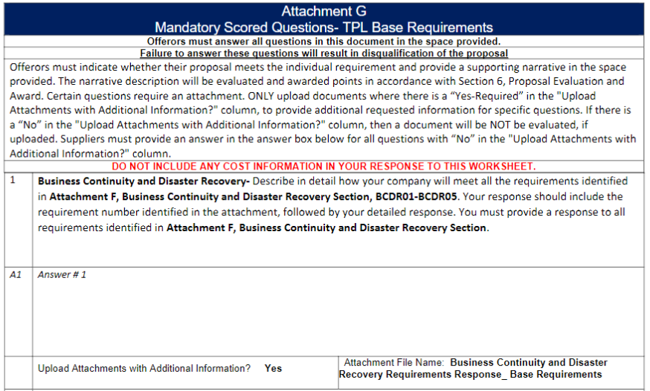
Mandatory Scored Response Worksheets
You are required to submit a response to the Base requirements and at least one service along with any other services for which you wish to bid
Answers should address requirements associated with questions identified in the attachment provided within each question
Answer in the space provided beneath each question or upload an attachment with your response where allowed using the attachment file name provided
Upload the response worksheet(s) requested and attachments using the file name provided to the procurement system
Notes:
Czarina

Slide 13
Requirements Spreadsheets
Base Response Worksheet
All answers to the mandatory scored questions should address the requirements identified in the attachment provided within each question
You must provide a response to all the requirements identified for a particular question on the Mandatory Scored Worksheets
Your response will be deemed non-responsive if all requirements are not addressed
Base Requirements Document
Notes:
Czarina

Slide 14
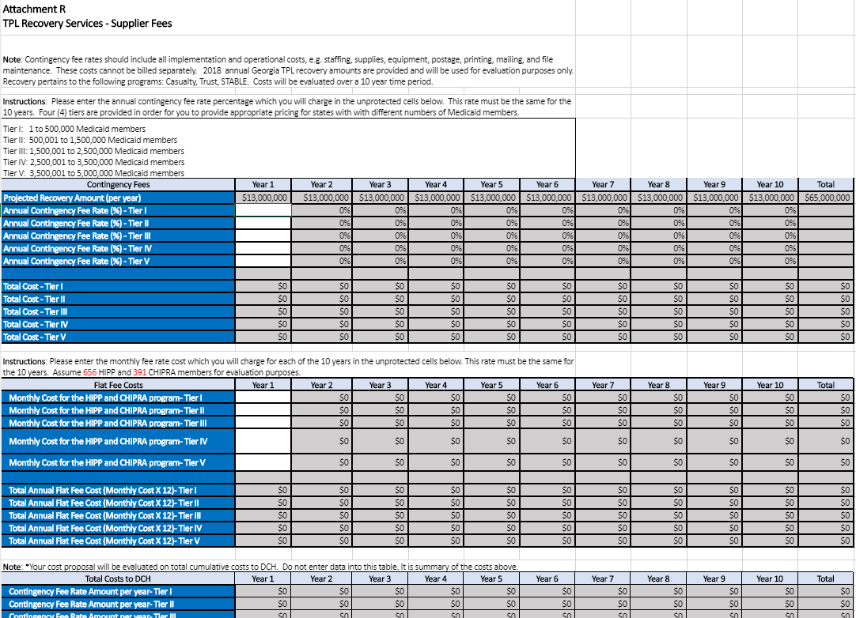
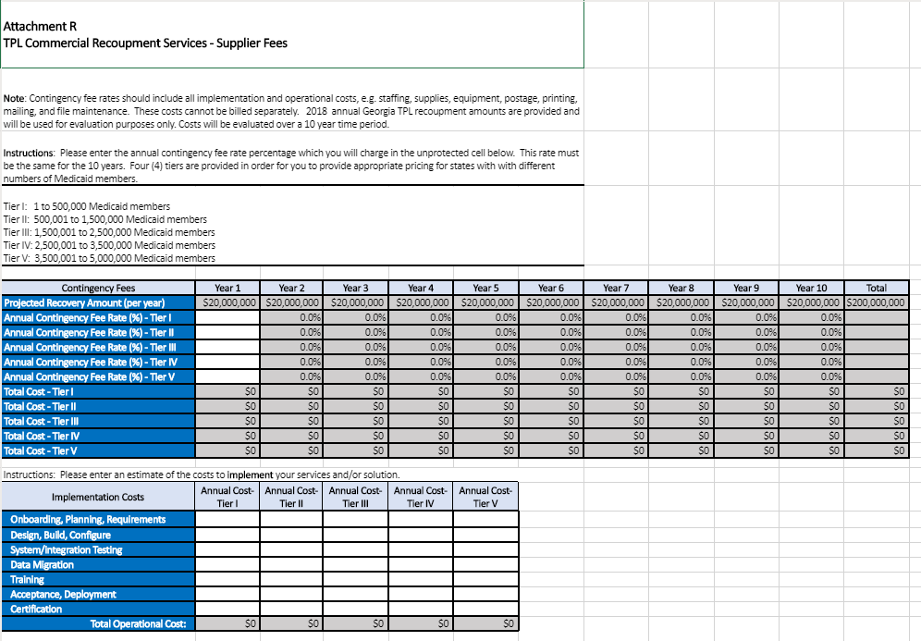
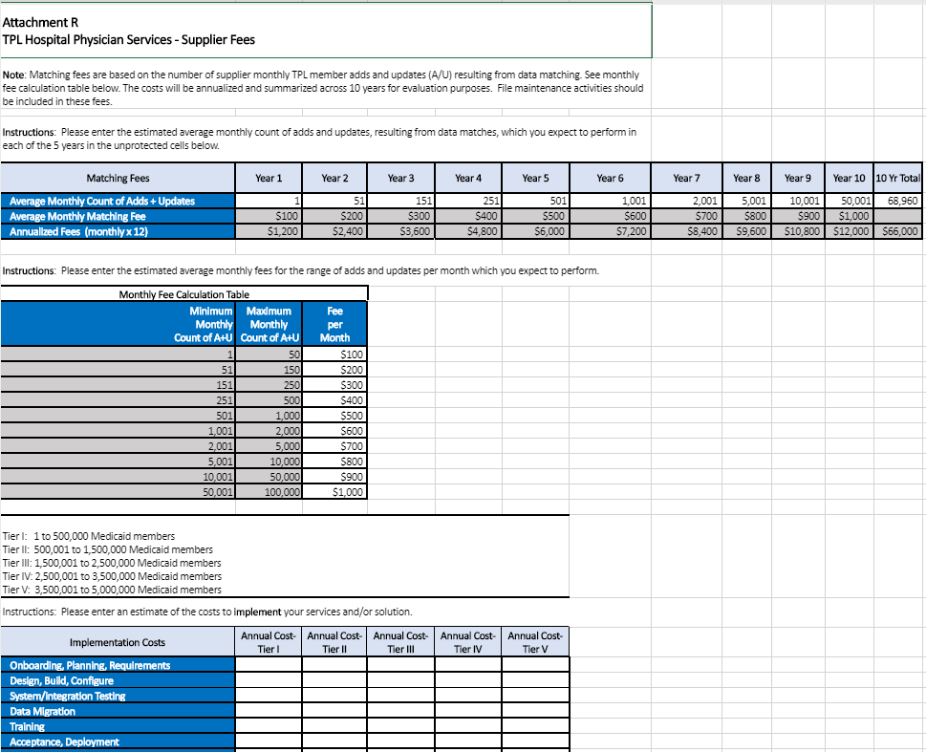
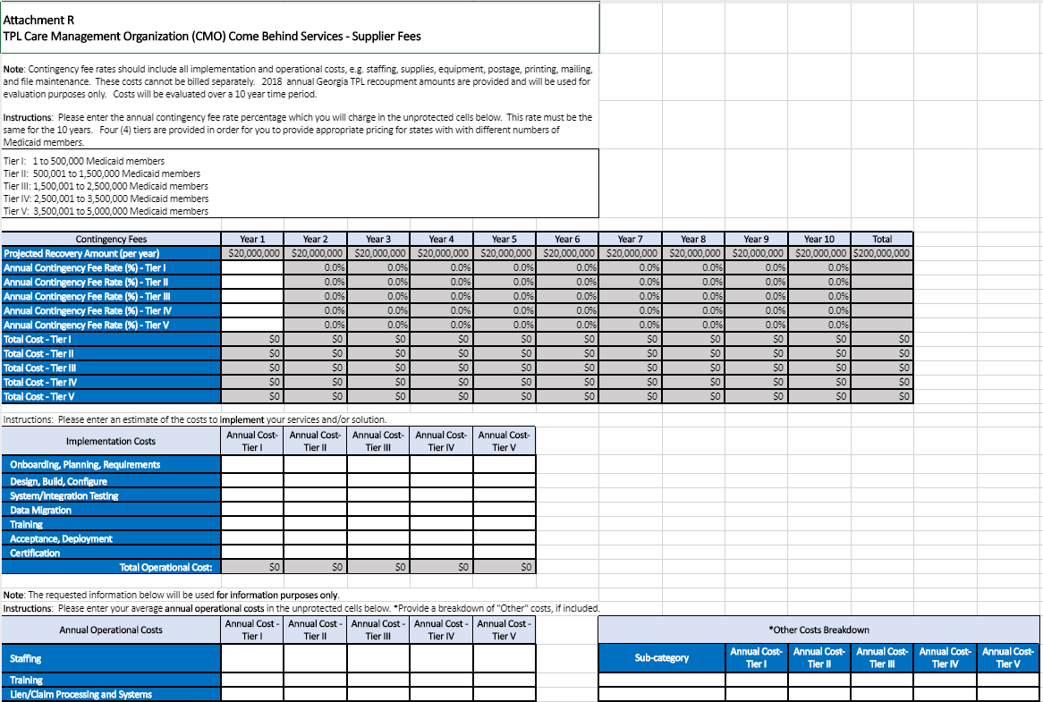
Cost Worksheet – TPL Business Services
Recovery
Commercial
Recoupment
Tab provided for each of 4 Business Services
Respond to tab for each Business Service bid
Provide contingency fee rates and flat rates, where requested
Only enter pricing in unprotected cells
Provide Implementation costs
Costs are tiered by count of Medicaid members to accommodate different States
Spreadsheets calculate annual totals for 10 years
Annual operational metrics are used for information purposes only, not scored
Hospital-
Physician
CMO CB
Notes:
Peter

Slide 15
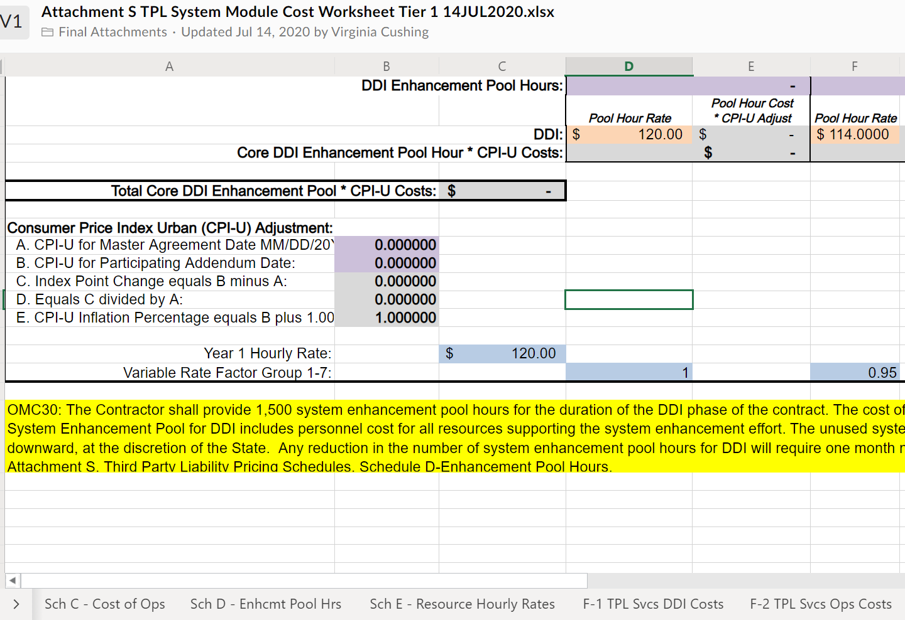
Cost Worksheet – TPL System Module
Review of Cost Worksheet
Tim Peterson
Notes:
Tim

Slide 16
Supplier Evaluation Process - Overview
The TPL procurement will use a “stage-gate” approach to narrow to a viable set of suppliers for each of the five TPL services. The two “gates” required for a supplier’s service to be finally evaluated are for the supplier to meet a minimum score on the base requirements questionnaire and then for a supplier to meet a minimum score on the technical questionnaire for each of their proposed services. Each service will be evaluated & qualified separately.
Base
Technical
Orals
Final
The objective of this phase of the NASPO VP process is find all qualified suppliers for a given service.
Notes:
Peter

Slide 17
Supplier Evaluation Process - Detail
Stage I - Each supplier must first score at least 600 of 1,000 possible base points (60%) or more on the base requirements questionnaire to be further evaluated. These points are not carried forward in the evaluation process.
A combined weighting of 70% for technical merit, 20% for oral presentations, and 10% for cost will be used for the suppliers who qualify for the remaining stages, with a total of a 1,000 (different) possible points for the final evaluation.
Stage II – Each supplier who successfully “passed” stage I, must now score 60% of the 700 possible points on the technical requirements questionnaire for each proposed service, in order to be invited to oral presentations for further evaluation of those services.
60% of 700 total possible points = 420 points or more is a “passing” score for each technical questionnaire
Stage III – Each supplier must now conduct an oral presentation about their proposed services which successfully “passed” stage II. The maximum points possible for orals for a given service proposed by a supplier is 200, 20% of 1,000 points.
DOAS and DCH Procurement will evaluate the cost competitiveness of supplier proposals for services which passed stage I and stage II. The maximum points possible for cost for a given service proposed by a supplier is 100, 10% of 1,000 points.
Final Stage - The technical, oral presentation, and cost scores for those supplier services which successfully passed stage I and stage II will be summed. Those supplier services which receive a score which is at least 50% of the 1,000 possible points will be considered qualified to provide that service.
The makeup of the total possible points for the final evaluation is: 700 points for technical, 200 points for oral presentations, and 100 points for cost.
50% of 1,000 total possible points = 500 points or above is a “passing” score for the final evaluation of each service proposed by each supplier.
Notes:
Peter

Slide 18
NASPO ValuePoint – How Does a Contract Start?
Ideas are generated by NASPO members
Surveys are distributed to all states
Projects are approved by the Management Board
Lead state model:
Lead state and multi-state/discipline sourcing team
NVP provides support
Lead state issues procurement under their own laws/process
Evaluation by lead state and sourcing team
Award recommendation sent to Management Board for approval
Notes:
Jerilyn

Slide 19
NASPO ValuePoint – Awards & Contracts
Once an Award has been made, The Lead State negotiates a MASTER AGREEMENT with awarded contractor(s).
Master agreement is the “umbrella agreement”
Administered by the Lead State’s Contract Administrator
Contains NVP Standard Terms and Conditions
All subsequent state or political subdivision agreements (Participating Addenda) fall under the master agreement States have ability to negotiate additional terms and conditions in PA’s
Notes:
Jerilyn

Slide 20
NASPO ValuePoint – Participating Addendum
A Participating Addendum is a bilateral agreement executed by a contractor and a State that incorporates the NASPO ValuePoint Master Agreement and adds any other additional state-specific language or other requirements.
Notes:
Jerilyn

Slide 21
How to Load Supplier Responses
Team Georgia Marketplace Demonstration
Julian Bailey
Notes:
Julian

Slide 22
Closing Remarks
RFP: 2020 Third Party Liability Services
RFP No. 41900-DCH0000120
Dates to remember:
Written questions sent via email to the Issuing Officer are due on October 26, 2020 by 5:00pm ET
Responses to written questions will be provided by November 9, 2020*
Proposals are due on December 1, 2020 by 5:00pm ET*
*Note: the Lead State reserves the right to adjust the proposed listed dates, including the dates for evaluation, negotiations, award and the contract term on an as needed basis with or without notice.
Do Not Wait. Post as you complete any of the attachments and be sure you “Submit” your submission prior to the 5:00pm deadline. File names should not exceed 54 characters.
Hint: While there is not file size limit, the larger the file the longer the upload will take.
Notes:
Gary

Slide 23
Questions
?
Notes:
Gary

